Slide 1
SKYTRAX AIRLINE REVIEW ANALYSIS
BA TECHNOLOGY, DATA, & INSIGHT
October 2022

Slide 2
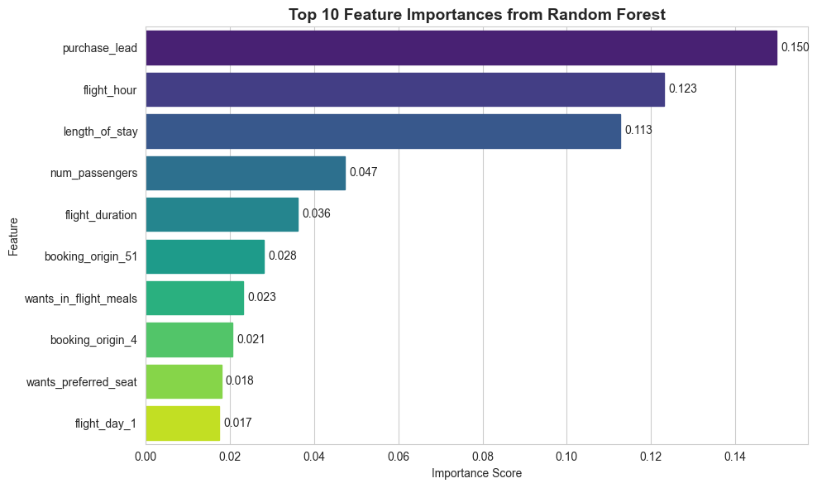
“The most impactful factors influencing bookings”
Flight Hour – likely ties to customer convenience.
Route – some routes may be more popular or price-sensitive.
Booking Origin – geography affects customer behavior.
Trip Type – round-trip vs one-way.
Sales Channel – online vs agent.

